Slide 1


CAPSTONE PROJECT
on
Ad Click Analysis for Targeted Marketing Optimization
Presented by Dhairya Yadav

Slide 2
OVERVIEW
Abstract
Result
Problem Statement
Conclusion
About Dataset
Methodology

Slide 3
ABSTRACT
In the digital advertising world, one of the most crucial aspects of ad campaigns is targeting the right users. The ability to understand and predict user behavior in response to ads enables businesses to optimize their ad delivery, thereby increasing click-through rates (CTR), conversions, and overall campaign success.This project aims to analyze user interaction data with ads, identify key behavioral patterns, and use that information to develop a predictive model for ad targeting optimization.

Slide 4
PROBLEM STATEMENT
Digital advertisers face the challenge of effectively targeting the right users to maximize engagement and conversions. Inefficient ad targeting leads to wasted ad spend, low click-through rates (CTR), and poor return on investment (ROI). The goal of this project is to identify patterns in user interactions with ads and develop a predictive model that optimizes ad targeting. By accurately predicting which users are most likely to engage with specific ads, advertisers can deliver more personalized campaigns, improve CTR, and increase overall ad effectiveness, leading to higher ROI.

Slide 5
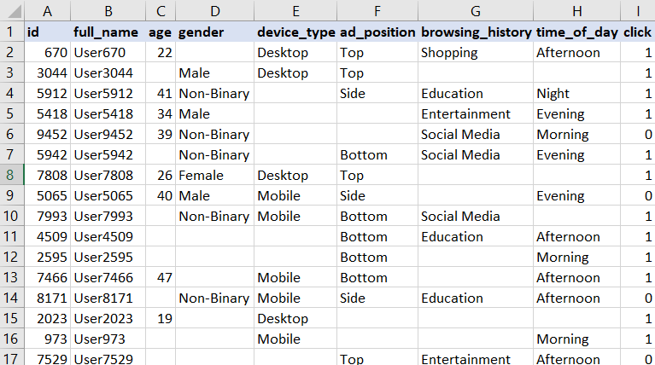
ABOUT DATASET
This dataset provides insights into user behavior and online advertising, specifically focusing on predicting whether a user will click on an online advertisement.
It contains user demographic information, browsing habits, and details related to the display of the advertisement.
This dataset is ideal for building binary classification models to predict user interactions with online ads.

Slide 6
METHODOLOGY
Data Collection:
Model Development:
Gather historical data on user interactions with ads, including user demographics, ad content, interaction details (clicks, views, conversions), and time of interaction.
Train machine learning models (Logistic Regression, Decision Trees, Random Forest, AdaBoost) to predict user engagement based on historical data.
Exploratory Data Analysis (EDA):
Model Evaluation:
Evaluate model performance using key metrics: accuracy, precision, recall, F1-score, and ROC-AUC.
Analyze user behavior to identify patterns such as engagement based on demographics, ad types, and time of day.

Slide 7
EDA QUESTIONS
Demographic Insights:
What are the age and gender distributions of users?
Does the likelihood of clicking on ads differ based on age or gender?
Device Type and Engagement:
How does the device type affect the click rate?
Ad Position Impact:
Is there a relationship between the ad position (Top, Side) and click-through rates?
Browsing History and Behavior:
How does a user’s browsing history (Shopping, Social Media, etc.) correlate with their click behavior?
Time of Day Influence:
Is there a trend in user engagement with ads across different times of the day (Morning, Afternoon, Evening, Night)?
Missing Data:
How prevalent is missing data across different columns (e.g., gender, device type)?
How should missing values be treated or imputed for analysis?

Slide 8
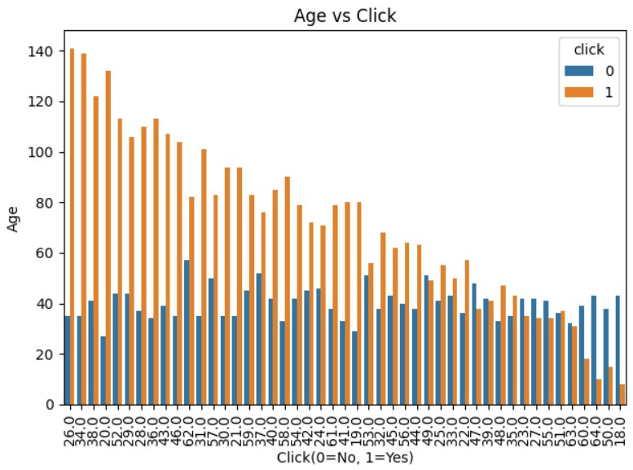
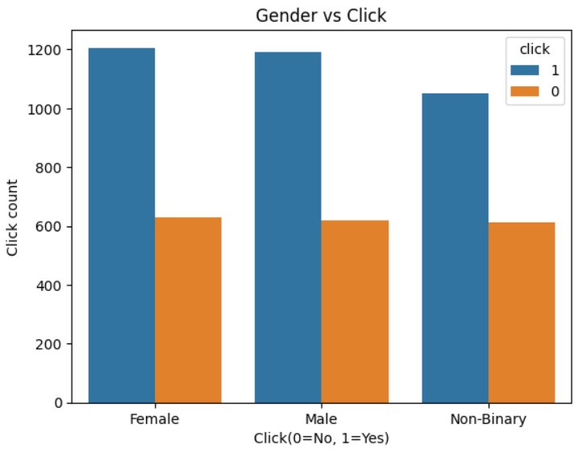
RESULT
Demographic Insights:
Does the likelihood of clicking on ads differ based on age?
What are the gender distributions of users with respect to click rate?
From the above distribution we can see that younger users are more likely to click on ads compared to older users.
From the above figure we can see that females and males are more likely to click on ads compared to non-binary individuals.

Slide 9
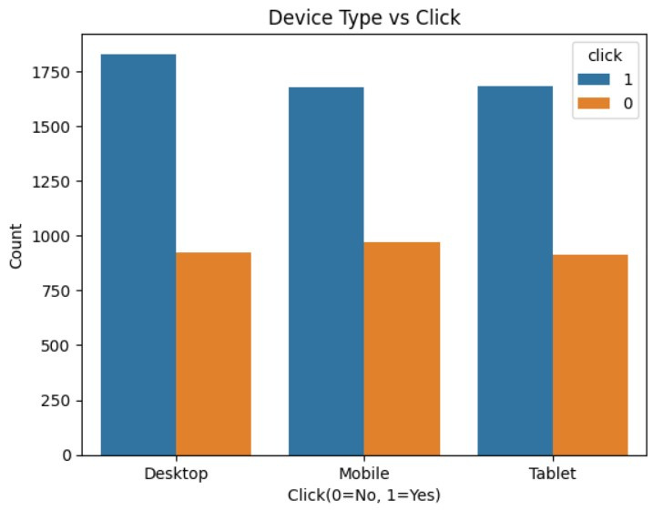
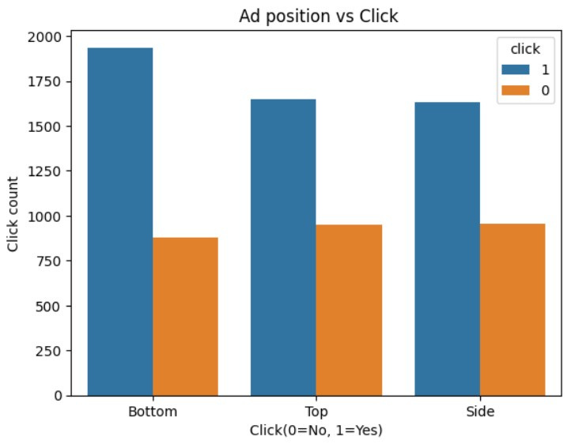
RESULT
Device Type and Engagement:
How does the device type affect the click rate?
Ad Position Impact:
Is there a relationship between the ad position (Top, Side) and click-through rates?
From the above graph, it seems like desktop is the most associated device with ad click.
From the above graph, it seems like ads at bottom side are clicked the most.

Slide 10
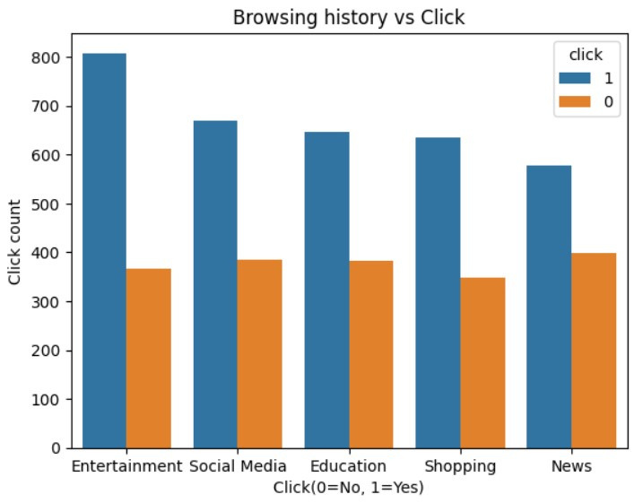
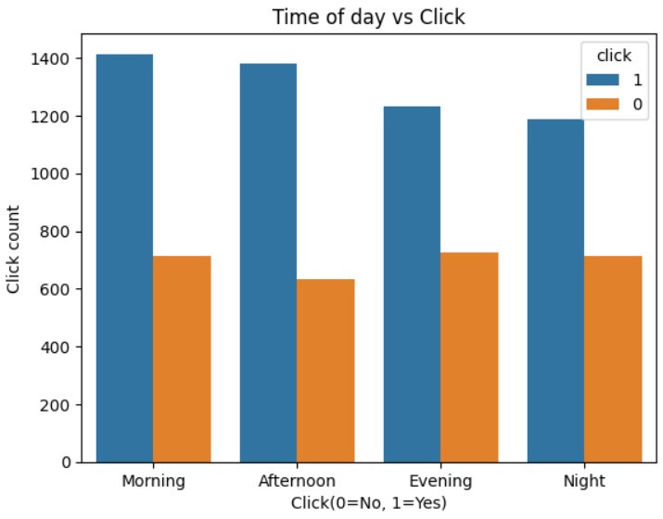
RESULT
Browsing History and Behavior:
How does a user’s browsing history (Shopping, Social Media, etc.) correlate with their click behavior?
Time of Day Influence:
Is there a trend in user engagement with ads across different times of the day?
From the above plot, it seems like Entertainment and social media is the most used platforms for ads.
From the above graph, it is clear that Morning and Afternoon is the busiest hour.

Slide 11
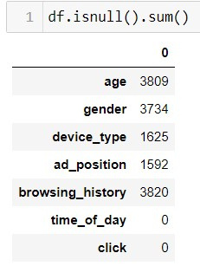
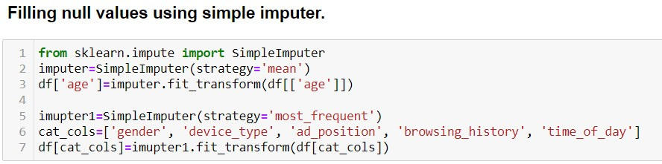
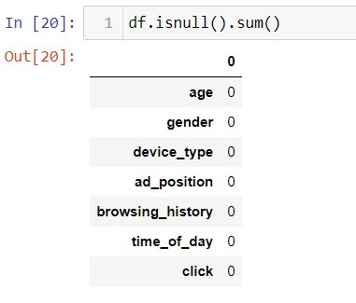
RESULT
Missing Data:
The major task in this dataset was to handle the missing values.
By using SKLearn library and Simple Imputer we filled missing values with mean of value for continuous feature and with the most number of occurence for categorical features.
Before cleaning
After cleaning

Slide 12
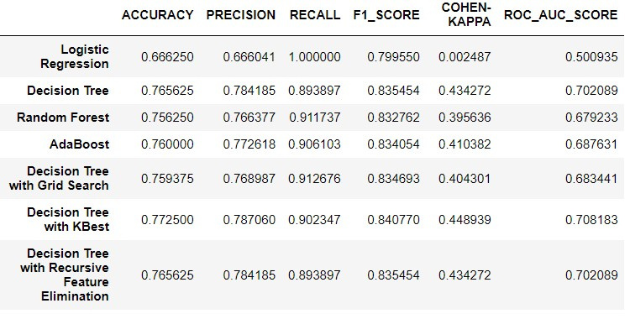
CONCLUSION
The Decision Tree with KBest feature selection outperforms other models, showing the highest accuracy (0.773), precision (0.787), F1 score (0.841), and ROC-AUC (0.708).
It provides the best balance between precision and recall.

Slide 13
Thank You
For your attention

